Slide 1
Homework 1 補充講義
Dr. Yu-Cheng Fan
National Taipei University of Technology, Taipei, Taiwan

Slide 2
Environment of Workstation

Slide 3

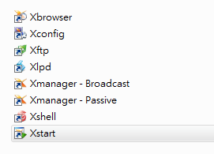
Environment of Worksation
Software : XManager

Slide 4
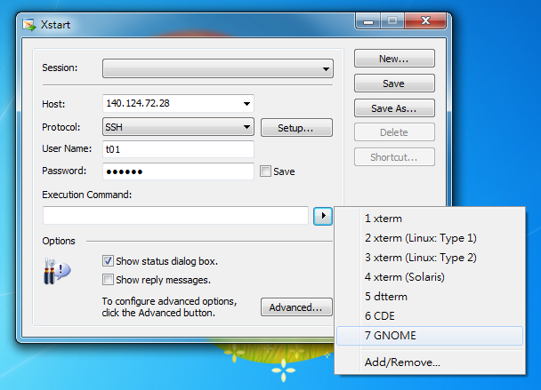
Workstation Practice
islabx5 : 140.124.72.28
islabx6 : 140.124.72.29

Slide 5
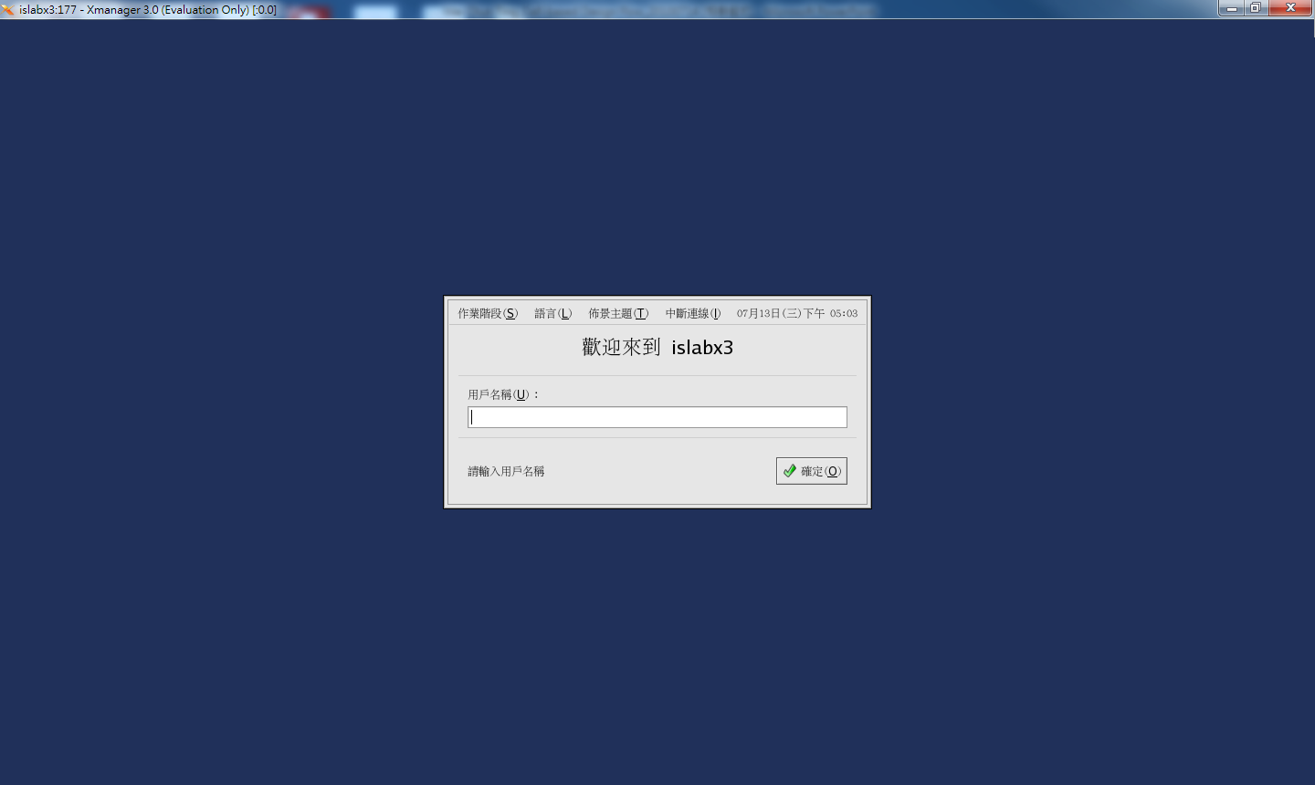
Environment of Workstation (cont.)
islabx5 : 140.124.72.28
islabx6 : 140.124.72.29
Dr. Yu-Cheng Fan National Taipei University of Technology Taipei, Taiwan

Slide 6
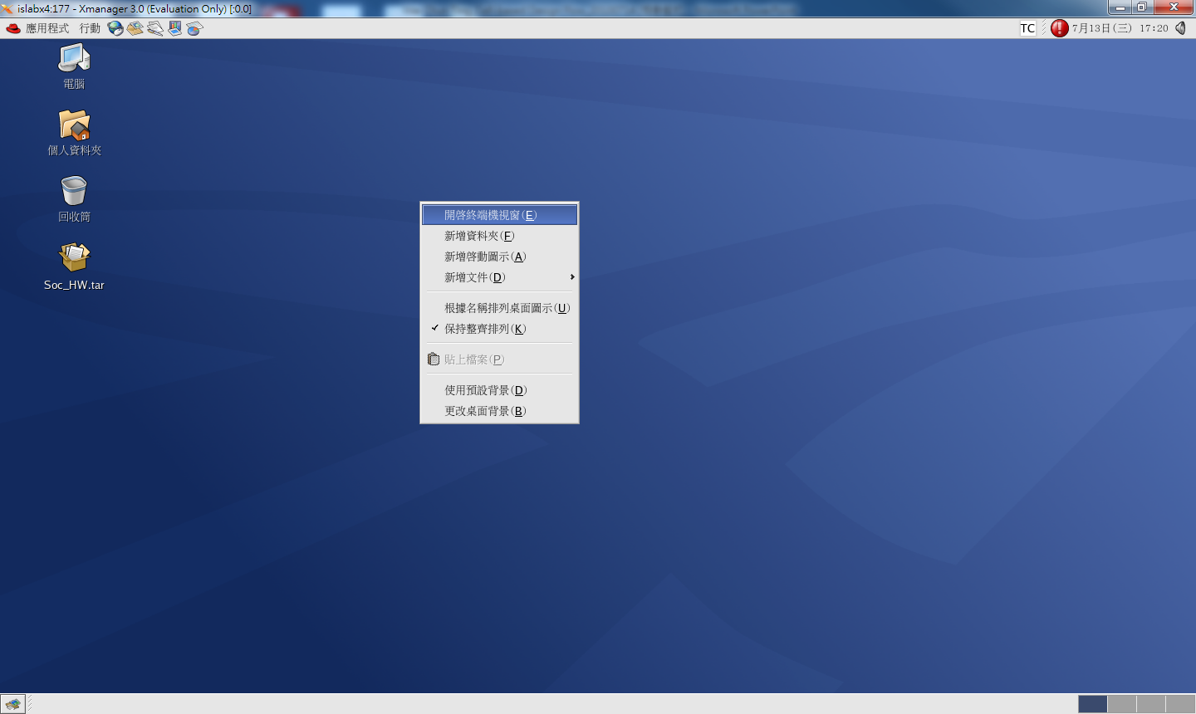
Environment of Workstation (cont.)
Dr. Yu-Cheng Fan National Taipei University of Technology Taipei, Taiwan

Slide 7
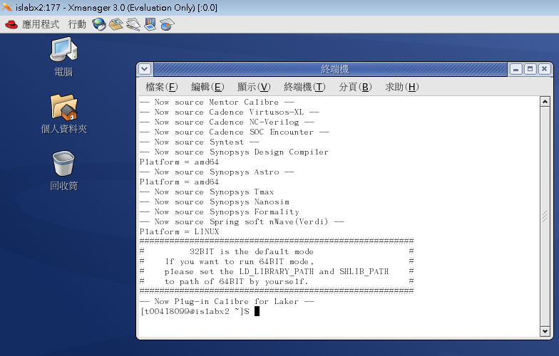
Environment of Workstation (cont.)
Dr. Yu-Cheng Fan National Taipei University of Technology Taipei, Taiwan

Slide 8


Setting the Environment
Set the environmental files
Open Terminal
Key in "cp /home/standard/Environment_Setup_File/cshrc .cshrc"
Key in " ls –a .cs* "
Key in " source .cshrc"
Copy the lab’s files
Command : cp -a /home/standard/electronic_circuit_101/verilog .
Command : ls
Dr. Yu-Cheng Fan National Taipei University of Technology Taipei, Taiwan

Slide 9
常用的基本指令集
cd （Change Directory）
cd 路徑 | 切換工作目錄至欲進入之目錄，絕對路徑或相對路徑皆可
cd . | 進入此層目錄，其實也就是沒有變動
cd .. | 回到上一層目錄，將工作路徑切換至當前目錄之父目錄
cd - | 切換至上一個工作目錄，用途如同電視遙控器之往返鍵
cd ~ | 切換工作目錄至帳號之家目錄
Dr. Yu-Cheng Fan National Taipei University of Technology Taipei, Taiwan

Slide 10
常用的基本指令集
資料處理相關指令
mkdir （Make Directory）
mkdir 目錄名稱，可在當前工作目錄建立出對應的資料夾
rm （Remove）
rm 檔案名稱，可針對單一檔案刪除
rm –r 目錄名稱，可刪除整個資料夾，但務必謹慎使用
cp （Copy），如同Windows系統中的複製
cp 來源 目標，來源與目標以相對路徑或絕對路徑來表示
cp –r 來源 目標，加入-r參數可以複製整個資料夾
mv （Move），如同Windows系統中的剪下
mv 來源 目標，與cp的使用方式相同，同樣可以利用-r參數
Dr. Yu-Cheng Fan National Taipei University of Technology Taipei, Taiwan

Slide 11
常用的基本指令集
相關輔助資訊
pwd （Print Work Directory）
在螢幕上列印出當前工作目錄之絕對路徑
ls （List）
在螢幕上列印出存在於當前工作目錄中所有檔案資訊
ls –a 可以連同隱藏檔案一同列出
ls –l 可以印出檔案的詳細資料，例如檔案權限
ls –la 完整功能
Dr. Yu-Cheng Fan National Taipei University of Technology Taipei, Taiwan

Slide 12
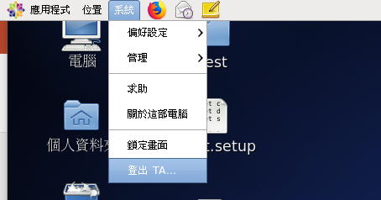
注意事項
請大家務必遵循正常方式登出，以免在不正常登出後，使得個人帳號程序無法正常登出工作站，進而遺失個人工作資料。
Dr. Yu-Cheng Fan National Taipei University of Technology Taipei, Taiwan

Slide 13
Vi編輯器的使用
vi編輯器雖然在初學時較為麻煩，且必須記住一些常用指令，與Windows系統的文字編輯方式有所差異，但在熟悉之後，可以非常直覺且快速地針對文件做編輯，甚至是進行系統操作和設定。
vi 文件名稱，透過這樣的指令輸入，即可開啟vi文字編輯器，vi主要分為兩種模式，文字編輯模式以及指令模式
Dr. Yu-Cheng Fan National Taipei University of Technology Taipei, Taiwan

Slide 14
Vi編輯器的使用
啟動vi編輯器後，即進入指令模式，我們必須透過指令進入文字編輯模式，如i、a、r、o等…
i | 從目前游標所在處插入，進入文字編輯模式
a | 從目前游標所在的下一個字元處插入，進入文字編輯模式
r | 取代游標所在處的字元一次，R則可持續取代模式
o | 於游標所在的下一行處插入新的一行，O則可於游標所在的上一行處插入新的一行，進入文字編輯模式
ESC | 退出文字編輯模式，回到指令模式
Dr. Yu-Cheng Fan National Taipei University of Technology Taipei, Taiwan

Slide 15
Vi編輯器的使用
常用的指令
在指令模式下除了進入文字編輯模式的指令之外，部分須先按冒號“： ”接著輸入操作指令
:w | 儲存目前編輯進度
:q | 離開vi文字編輯器，在尚未儲存時無法離開
:q! | 加入驚嘆號則能於未儲存的狀態下強制離開
:wq | 先將編輯進度儲存後，離開vi文字編輯器
gg | 移動到該文件的第一行
G | 移動到該文件的最後一行
nG | n為任意數字，若輸入100G則是移動至該文件中第100行
Dr. Yu-Cheng Fan National Taipei University of Technology Taipei, Taiwan

Slide 16
Vi編輯器的使用
/word | word為任意文字，搜尋是否存在於該文件中 利用n則可搜尋下一個word的位置 利用N則可找到上一個word的位置
dd | 刪除游標所在處整行文字，但實際上會將這些資料放入資料暫存區內，即等同於剪下的效果
yy | 複製游標所在處整行文字，放入資料暫存區內
 | dd 及 yy 皆可與n (數量，n為任意數字)搭配，做多行資料的處理
p | 將資料暫存區內的資料貼到游標所在的下一行處
Dr. Yu-Cheng Fan National Taipei University of Technology Taipei, Taiwan

Slide 17
Reference
http://linux.vbird.org/ 鳥哥的Linux私房菜
Dr. Yu-Cheng Fan National Taipei University of Technology Taipei, Taiwan

Slide 18
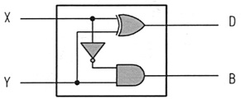
The Circuit of Half – Subtractor
Half – Subtractor (H.S.)
Two inputs (X, Y) and two outputs (D, B).
The “D” means “Difference”.
The “B” means “Borrow”.
Truth Table
Circuit
X | Y | B | D
0 | 0 | 0 | 0
0 | 1 | 1 | 1
1 | 0 | 0 | 1
1 | 1 | 0 | 0
Dr. Yu-Cheng Fan National Taipei University of Technology Taipei, Taiwan

Slide 19
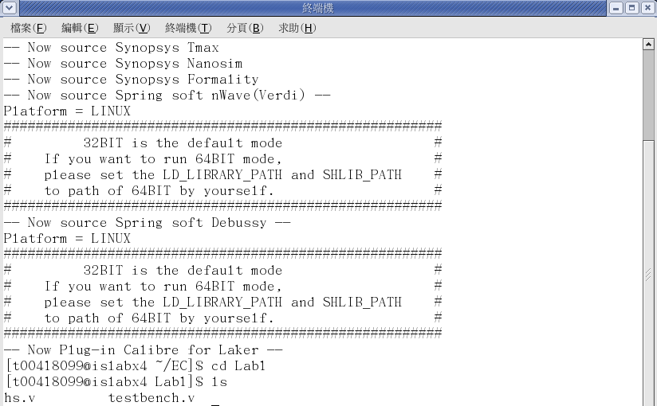
Practice of Editor
Open the verilog file
cd verilog/Lab1
ls
vi hs.v or gedit hs.v
Dr. Yu-Cheng Fan National Taipei University of Technology Taipei, Taiwan

Slide 20
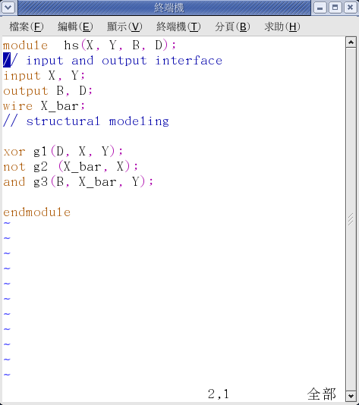
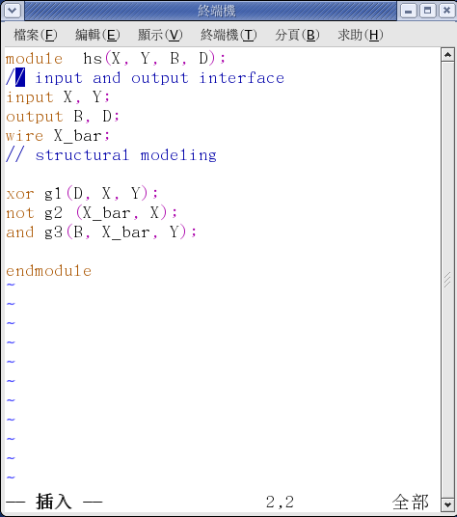
Practice of Editor (cont.)
The vi editor
Command : vi <filename>
Normal Mode => Press ‘a’ => Edited Mode
Edited Mode => Press ‘Esc’ => Normal Mode
:w | Write
:q | Exit (without save)
:wq | Write and Exit
:x
/keyword | search the “keyword” word
Normal Mode
Edited Mode
Dr. Yu-Cheng Fan National Taipei University of Technology Taipei, Taiwan

Slide 21
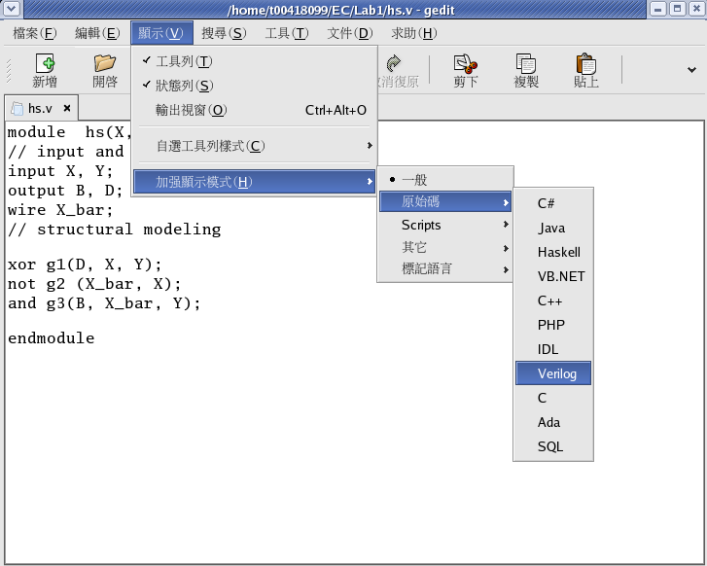
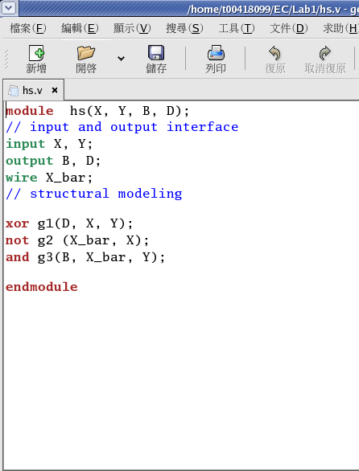
Practice of Editor (cont.)
The gedit editor
Command : gedit <filename>
Dr. Yu-Cheng Fan National Taipei University of Technology Taipei, Taiwan

Slide 22
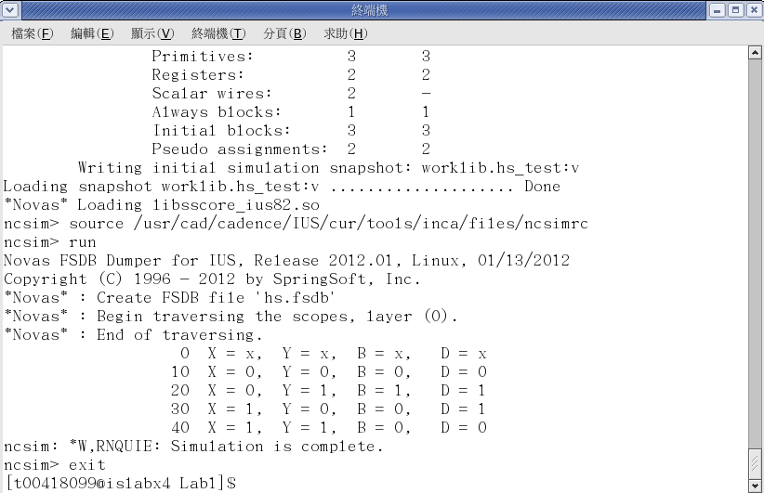
Practice of Verilog Compiler
To compile the verilog code
Using the NC-Verilog Compiler.
Command : ncverilog testbench.v hs.v +access+r +FSDB
Dr. Yu-Cheng Fan National Taipei University of Technology Taipei, Taiwan

Slide 23
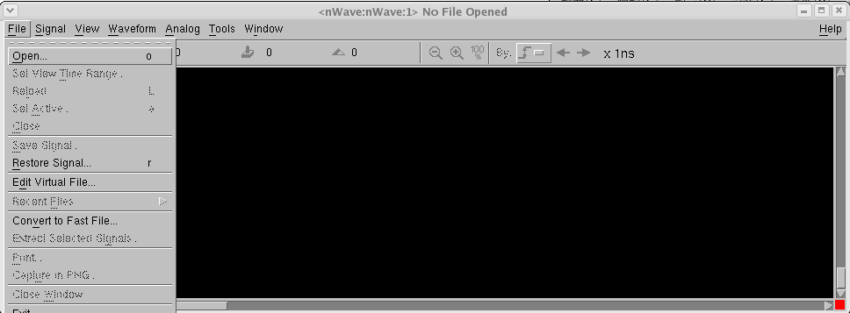
Practice of Waveform Browser
Software : Verdi - nWave
Command : nWave
File => Open
1
2
Dr. Yu-Cheng Fan National Taipei University of Technology Taipei, Taiwan

Slide 24
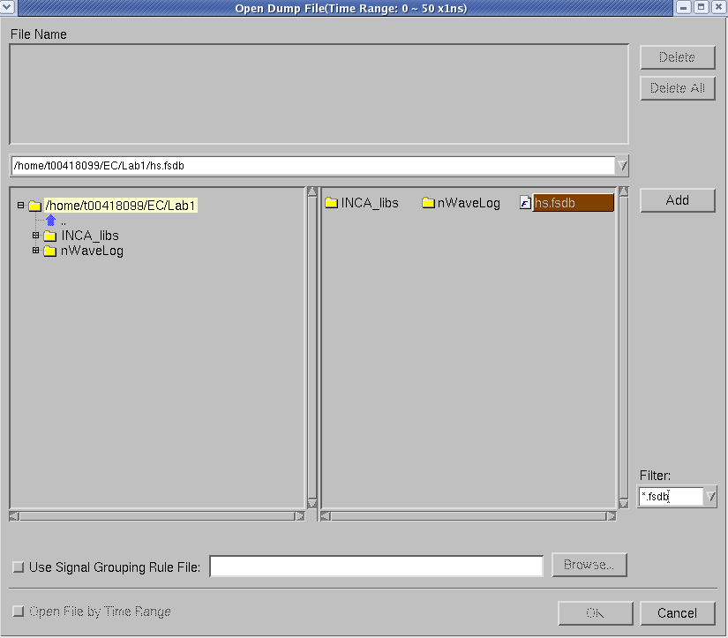
Practice of Waveform Browser (cont.)
Opening the waveform file.
Double click the hs.fsdb => Press ‘OK’
1
Double Click
2
Dr. Yu-Cheng Fan National Taipei University of Technology Taipei, Taiwan

Slide 25
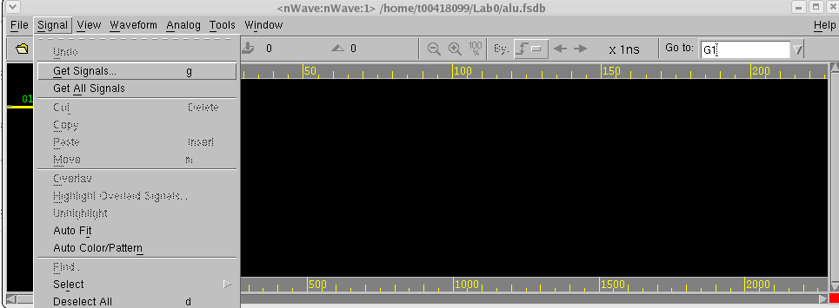
Practice of Waveform Browser (cont.)
Adding signals
Signal => Get Signals
1
2
Dr. Yu-Cheng Fan National Taipei University of Technology Taipei, Taiwan

Slide 26
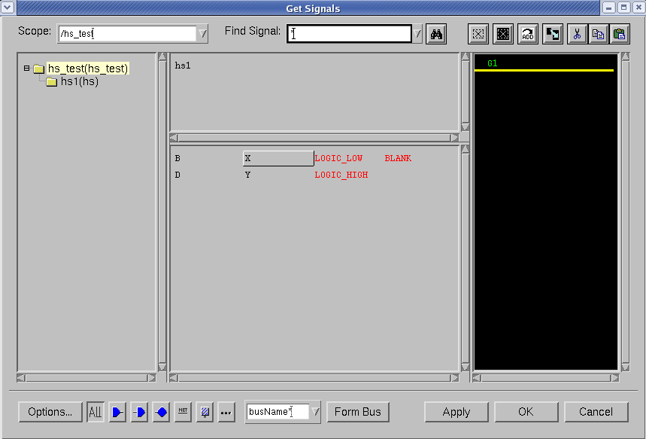

Practice of Waveform Browser (cont.)
Adding signals (cont.)
Find these signals => Double click => Press “OK”
1
Find these signals as below.
2
3
Dr. Yu-Cheng Fan National Taipei University of Technology Taipei, Taiwan

Slide 27
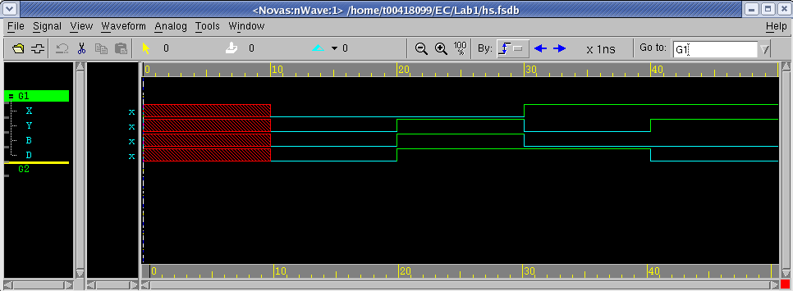
Practice of Waveform Browser (cont.)
To view the signals.
Dr. Yu-Cheng Fan National Taipei University of Technology Taipei, Taiwan

Slide 28
NC-Verilog

Slide 29
Outline
Introduction to HDL(Hardware Description Languages)
Verilog
Introduction
Verilog Operator
Main Structure of Verilog
Circuit Description by Verilog
Combinational Circuit with wire
Combinational Circuit with reg
Sequential Circuit with reg
Labs
Dr. Yu-Cheng Fan National Taipei University of Technology Taipei, Taiwan

Slide 30
Introduction
HDL, Hardware Description Language, is a high-level programming language used to
Describe the connectivity of circuits
Describe the functionality of circuits
Describe the levels of abstraction of circuits
Describe the timing of circuits
Common Hardware Description Language
Verilog
VHDL
Dr. Yu-Cheng Fan National Taipei University of Technology Taipei, Taiwan

Slide 31
Introduction
Introduction to Verilog
Verilog is used to express the circuit of FPGA or ASIC
Verilog designer intends to design a HDL based on C language to simplify the learning of engineer
Verilog is not a programming language for PC but a HDL
Verilog is able to describe the testing model to verify your circuit
The verilog code of circuit must be synthesizable to implement
↑
What is
Dr. Yu-Cheng Fan National Taipei University of Technology Taipei, Taiwan

Slide 32
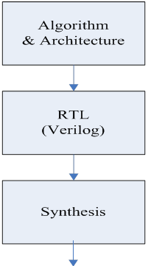
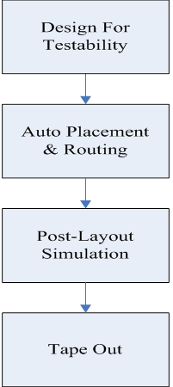
Cell-Based Design Flow
←Synthesizable
Dr. Yu-Cheng Fan National Taipei University of Technology Taipei, Taiwan

Slide 33
Verilog
Operator of Verilog
Arithmetic
+
-
*
/
%
Comparative
>
<
>=
<=
==
!=
===
!==
Logical
!
&&
||
Binary
~
&
|
^
~^
Others
>>
<<
{}
?:
－：Synthesizable
－：Synthesizer Decided
－：Non-synthesizable
Dr. Yu-Cheng Fan National Taipei University of Technology Taipei, Taiwan

Slide 34
Verilog
Main Structure of Verilog – Module Based
module ModuleName;
．
．
．
endmodule
Without input or output ports
Commonly used to design the testbench
Testbench
Used to verify the designed circuit. Testbench will send the control signals like “clk”, “rst” or “enable” to the circuit and send testing patterns to the circuit. And it’ll receive the output signal from the circuit and verify it with the correct answer.
－：Fixed Syntax
－：User Defined
Dr. Yu-Cheng Fan National Taipei University of Technology Taipei, Taiwan

Slide 35
Verilog
Main Structure of Verilog – Module Based
module ModuleName( input1, input2, ..., inputN
output1, output2, ..., outputN);
input [n-1:0] input1, input2; //n bits input port
input input3; //1 bit input port
output [n-1:0] output1; //n bits output port
output output2; //1 bit output port
．
．
．
endmodule
－：Fixed Syntax
－：User Defined
Dr. Yu-Cheng Fan National Taipei University of Technology Taipei, Taiwan

Slide 36
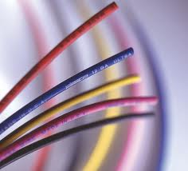
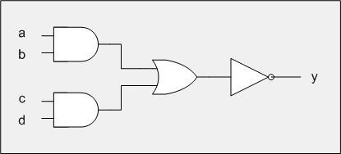
Verilog
Circuit Description by Verilog
There are 2 common data type in verilog
wire – Only used to design combinational circuit
reg – Used to design combinational & sequential circuit
Combinational Circuit Design with wire
What is wire?
Dr. Yu-Cheng Fan National Taipei University of Technology Taipei, Taiwan

Slide 37
Verilog
Combinational Circuit Design with wire
Wire is the default data type in verilog
To assign circuits of a wire :
module AOI(a, b, c, d, y);
input a, b, c, d; //1 bit input port
output y; //1 bit output port
assign y = ~((a & b) | (c & d));
endmodule
Dr. Yu-Cheng Fan National Taipei University of Technology Taipei, Taiwan

Slide 38
Verilog
Combinational Circuit Design with reg
Circuit composed of reg data type must be describe in always block
module AOI(a, b, c, d, y);
input a, b, c, d; //1 bit input port
output y; //1 bit output port
endmodule
reg y;
always@(a, b, c, d)
begin
y = ~((a & b) | (c & d));
end
Dr. Yu-Cheng Fan National Taipei University of Technology Taipei, Taiwan

Slide 39


Verilog
Sequential Circuit Design with reg
What is register?
DQ
↑ CK
Dr. Yu-Cheng Fan National Taipei University of Technology Taipei, Taiwan

Slide 40
Verilog
Sequential Circuit Design with reg
module adder(clk, A, B, Sum);
input clk;
input [7:0] A, B;
output [8:0] Sum;
endmodule
8
In0 Out
Adder_8bits
In1
9
9
DQ
↑
9
A
reg [8:0] Sum;
always@(posedge clk)
begin
Sum <= A + B;
end
SUM
8
clk
posedge clk
B
Dr. Yu-Cheng Fan National Taipei University of Technology Taipei, Taiwan

Slide 41
Verilog
Sequential Circuit Design with reg
module add_sub(clk, A, B, Out);
input clk;
input [7:0]A, B;
output [8:0]Out;
reg [8:0] Out;
always@(*)
begin
if(Q)
Out = A+B;
else
Out = A-B;
end
endmodule
reg Q;
always@(posedge clk)
begin
Q <= !Q;
end
Dr. Yu-Cheng Fan National Taipei University of Technology Taipei, Taiwan

Slide 42
Lab MUX
Dr. Yu-Cheng Fan
National Taipei University of Technology, Taipei, Taiwan

Slide 43
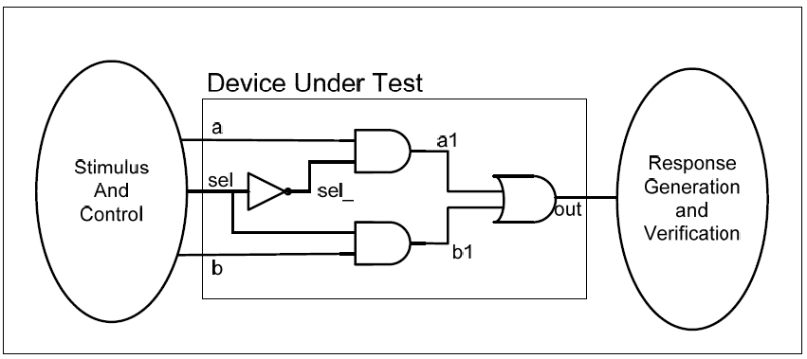
LAB MUX
and g1(out,in1,in2);
or g2(out,in1,in2);
not g3(out,in);
Please design a 2 to 1 MUX
Specifications
Module name : mux
Input pins : a, b, sel
Output pins : out
Dr. Yu-Cheng Fan National Taipei University of Technology Taipei, Taiwan

Slide 44
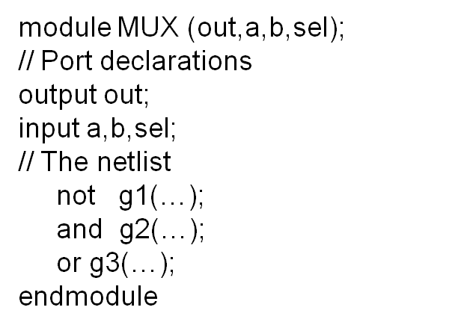
LAB MUX
利用上述電路圖完成2對1的多工器，當sel為0時out輸出a的值，當sel為1時，out輸出b的值。
開啟mux.v的檔案，完成上述電路的RTL Code ， 範例如下。
Dr. Yu-Cheng Fan National Taipei University of Technology Taipei, Taiwan

Slide 45
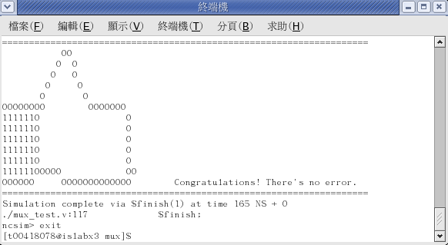
LAB MUX
完成RTL Code之後，使用NC-verilog來執行Simulation。
Unix% ncverilog mux_test.v mux.v +access+r
此lab的測試程式有比對功能，假如多工器功能正常，會在終端機顯示no error。
Dr. Yu-Cheng Fan National Taipei University of Technology Taipei, Taiwan

Slide 46
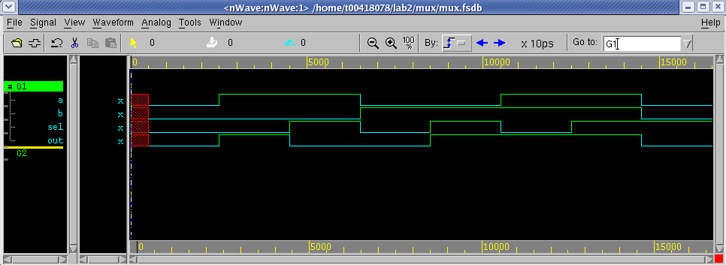
LAB MUX
使用nWave來觀測波形，是否符合多工器之功能?
Unix% nWave &
Dr. Yu-Cheng Fan National Taipei University of Technology Taipei, Taiwan

Slide 47
LAB MUX
也可以請同學嘗試自己撰寫簡單的testbench file，新增一個名為mux_test2.v的檔案並輸入自己所撰寫的測試檔，完整範例如下。
module mux_test;
reg a, b, sel;
mux mux (out, a, b, sel);
// Apply Stimulus
initial
fork
// ** Add stimulus here **
#10 begin a = 0; b = 0; sel = 0;end
#20 begin a = 1; b = 0; sel = 1;end
#30 begin a = 1; b = 1; sel = 0;end
#40 begin a = 0; b = 1; sel = 1;end
#50 begin a = 0; b = 1; sel = 0;end
#60 begin a = 1; b = 0; sel = 0;end
#70 begin a = 0; b = 0; sel = 1;end
#80 begin a = 1; b = 1; sel = 1;end
#100 $finish;
// ** Add stimulus here **
join
// Display Results
initial // print all changes to all signal values
$monitor($time, " a = %b, b = %b, sel = %b, out = %b", a,b,sel,out);
// Waveform Record
initial
begin
$fsdbDumpfile("mux.fsdb"); // The FSDB Database
$fsdbDumpvars;
end
endmodule
Dr. Yu-Cheng Fan National Taipei University of Technology Taipei, Taiwan

Slide 48
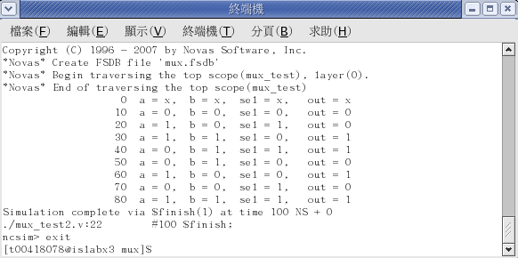
LAB MUX
完成自己所編寫的mux_test2.v，使用NC-verilog來執行Simulation，可以看到輸出結果。
Unix% ncverilog mux_test2.v mux.v +access+r
這個mux_test2.v只會將輸入的值經過mux做輸出，我們可以經由終端機觀察out的值是否符合mux的功能。
Dr. Yu-Cheng Fan National Taipei University of Technology Taipei, Taiwan

Slide 49
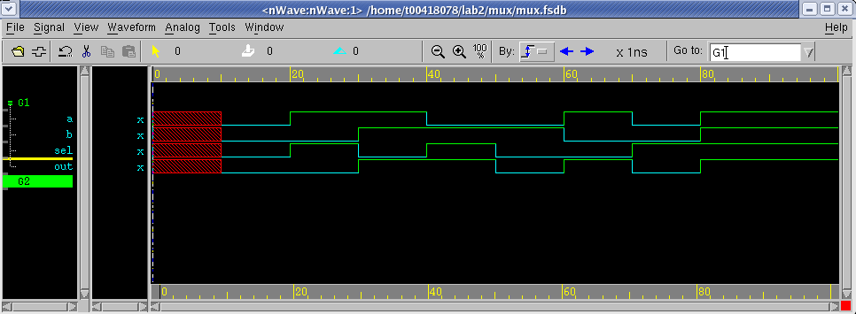
LAB MUX
使用nWave來觀測波形，是否與終端機所出現的值相同?
Unix% nWave &
Dr. Yu-Cheng Fan National Taipei University of Technology Taipei, Taiwan

Slide 50
Lab Full Adder Model Design -Full Adder and Half Adder
Dr. Yu-Cheng Fan
National Taipei University of Technology, Taipei, Taiwan

Slide 51
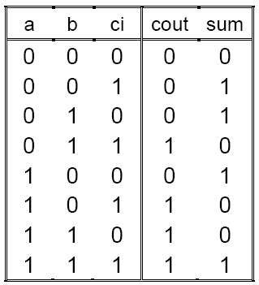
Full Adder
Please design a Full-Adder Specifications
Module name : fa
Input pins : a, b, ci
Output pins : sum, cout
Function : { cout, sum } = a + b + ci
Dr. Yu-Cheng Fan National Taipei University of Technology Taipei, Taiwan

Slide 52
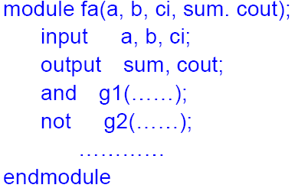
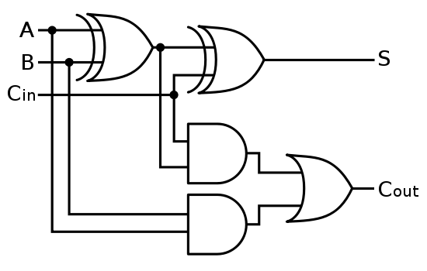
Full Adder
開啟fa.v檔案之後，參考上頁真值表，使用Structural Modeling的方式撰寫Full adder之RTL Code，在RTL Code中可以使用Verilog語言所內建的built-in primitives來描述電路的連結與架構，如下圖範例所示。
,
a
b
ci
sum
cout
Dr. Yu-Cheng Fan National Taipei University of Technology Taipei, Taiwan

Slide 53
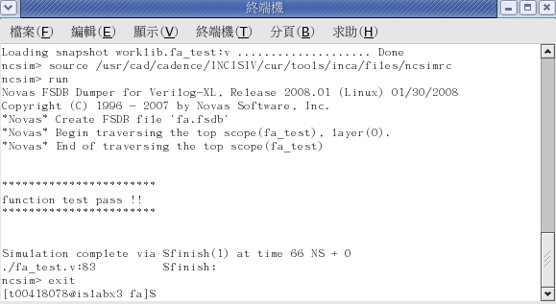
Full Adder
完成RTL Code之後，使用NC-verilog來執行Simulation。
Unix% ncverilog fa_test.v fa.v +access+r
此lab的測試程式有比對功能，假如全加器功能正常，會在終端機顯示function test pass 。
Dr. Yu-Cheng Fan National Taipei University of Technology Taipei, Taiwan

Slide 54
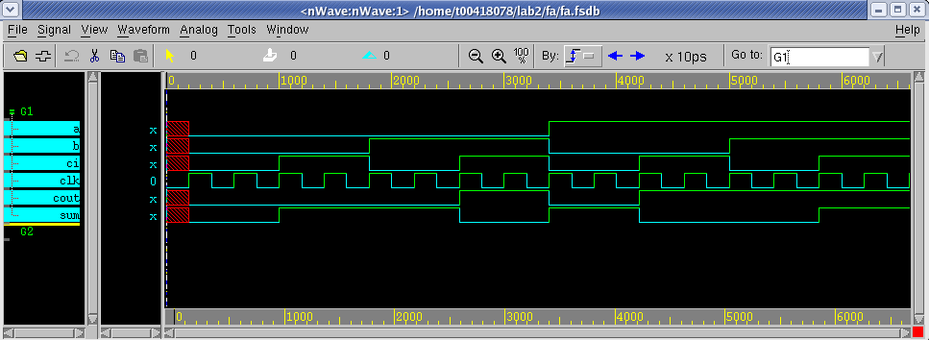
Full Adder
使用nWave來觀測波形，是否功能與全加器的真值表功能相同?
Unix% nWave &
Dr. Yu-Cheng Fan National Taipei University of Technology Taipei, Taiwan

Slide 55
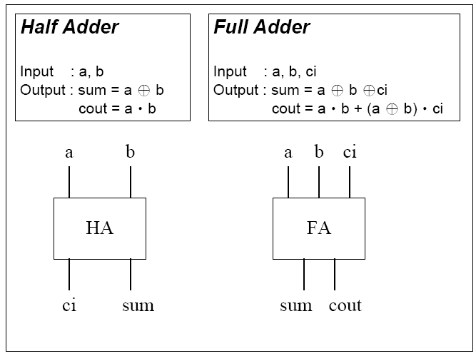
Full Adder and Half Adder
Please design a Full-Adder Specifications
Module name : fa
Input pins : a, b, ci
Output pins : sum, cout
Function : { cout, sum } = a + b + ci
Dr. Yu-Cheng Fan National Taipei University of Technology Taipei, Taiwan

Slide 56
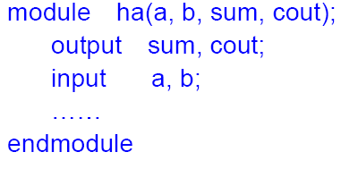
Full Adder and Half Adder
如上頁圖所示，一個全加器也能使用兩個半加器與一些邏輯閘組合而成。
在這個實習中，請先打開Half Adder(ha.v)的程式，並使用Structural Modeling的方式完成。
Dr. Yu-Cheng Fan National Taipei University of Technology Taipei, Taiwan

Slide 57
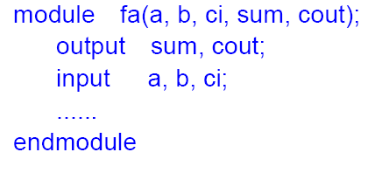
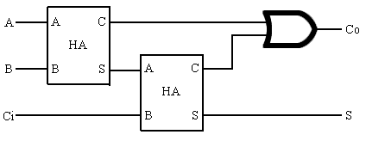
Full Adder and Half Adder
在完成Half Adder(ha.v)的程式之後，儲存檔案並關閉，接著打開fa2.v撰寫Full Adder Module的程式。
在這次的Full Adder Module中請使用Connecting ports的方式呼叫Half Adder的Module Instance，使用此方法完成fa2.v 。
ha.v
a
b
ci
a cout
b sum
cout
sum
ha.v
a cout
b sum
ha inst (.a( ),
.b( ),
.sum( ),
.cout( ));
Dr. Yu-Cheng Fan National Taipei University of Technology Taipei, Taiwan

Slide 58
Full Adder and Half Adder
完成RTL Code之後，使用NC-verilog來執行Simulation。
Unix% ncverilog fa_test.v fa2.v ha.v +access+r
此lab功能會與剛剛使用Structural Modeling的方式撰寫Full adder的功能一樣，所以模擬成功後也會在終端機顯示function test pass，最後再開起nWave觀看波形與上個lab是否相同。
Dr. Yu-Cheng Fan National Taipei University of Technology Taipei, Taiwan

Slide 59


Dr. Yu-Cheng Fan National Taipei University of Technology Taipei, Taiwan

